Slide 1
Updates from Brain Health Scotland Alison McKean Executive Lead for Brain Health and Research

Slide 2
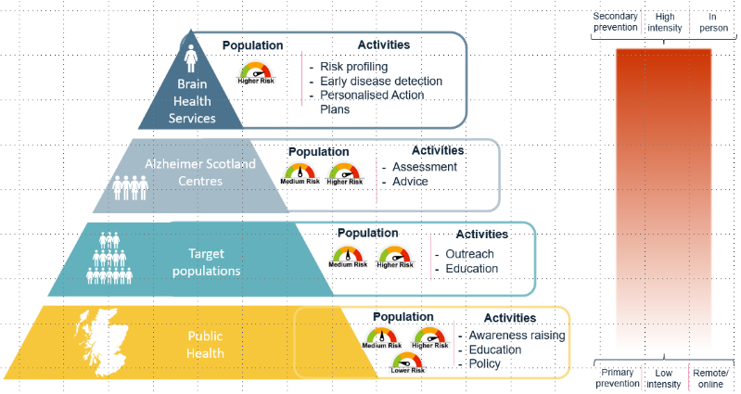
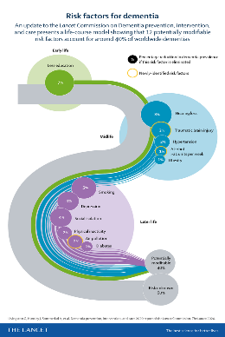
Delivery Model
Notes:
Brain Health Scotland has been established to reduce the incidence of dementia across Scotland over the next ten years

Slide 3
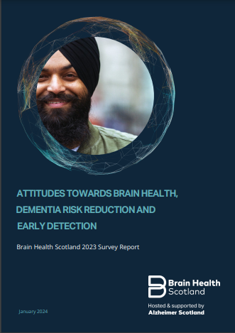
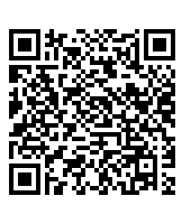
Attitudes Survey Report 2023
Uncertainty about risk reduction
Continue to raise awareness about risk reduction in Scotland and tailor initiatives according to different demographics
Focus on the affordability of the proposed intervention or communication (particularly around healthy diet)
88% interested in early detection - but half of these only if there were treatments or ways to prevent progression
Positive attitudes towards activities promoting brain health
Notes:
941 Participants across Scotland, median age 44 years old, 47% male, 53% female
Age between 18 years old and 86 years old
Almost half of the participants were unaware about risk reduction.
Target less advantaged background and younger groups
Initiatives aimed at risk reduction may find a responsive audience in those aged 35-44 years old
Accessible information on various media platforms
Actionable and practical suggestions

Slide 4
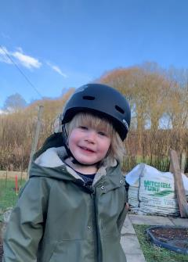
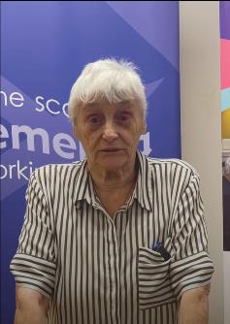
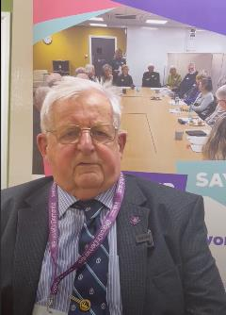
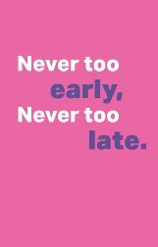
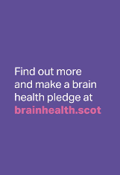
Awareness Raising
Wears helmet to keep brain safe
Brownies, learning new skills every week
Walks dog four
times a day
Model building hobby keeps brain active

Slide 5
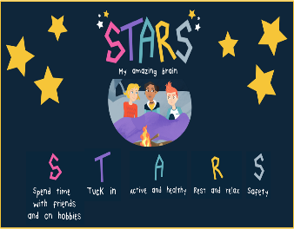
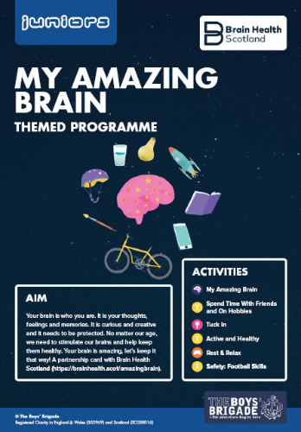
Partnerships
STARS My Amazing Brain Schools Programme and The Boys Brigade
Focus on STARS:
Spend time
Tuck in
Active
Rest
Safety
+ Activity related to Boys Brigade
core mission and values
Notes:
The Boys Brigade is a youth organisation for boys, the programme provides challenges, adventure and opportunities for around 40,000 kids and 1200 leaders. In 2023 for their Autumn/ Winter term activity pack Brain Health Scotland collaborated with the Boys Brigade to create The STARS My Amazing Brain themed pack - 6 activity cards for each of the STARS (Spend time, Tuck in, Active, Rest and Safety) and one card relating to the boys brigade core mission and values with a brain health twist.

Slide 6
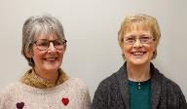
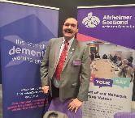
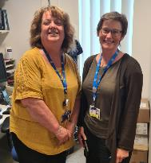
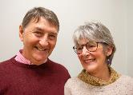
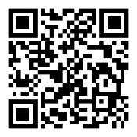
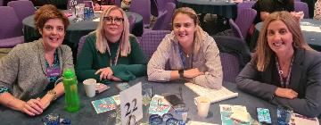
Healthcare System Preparedness for Early
Detection of Alzheimer’s
Next generation tools into new & existing clinical pathways
(Digital Cognitive Assessment & Blood Based Biomarker)
Scottish Dementia Working Group promoting the importance of early detection and diagnosis
Open access digital Blueprint developed:
https://www.dacblueprint.org/

Slide 7
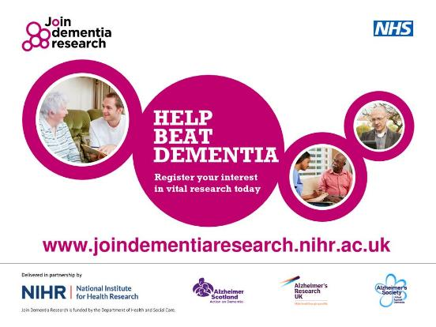
Join Research

Slide 8
Brain Health Clinic Developments Dr Catherine Pennington Clinical Advisor

Slide 10
Aberdeen Brain Health Clinic
‘Walk in’ – city centre location
Initial contact with a Centre Manager (non-clinical)
Opportunity to complete a risk factor questionnaire
Signposting to NHS & self-guided support with risk factor modification

Slide 11
Referral Sources
Self-referral via the Brain Health Resource Centre
Referral from local public health phone, online or in-person services
GP
Re-direction of referrals from NHS Memory clinics

Slide 13
Audit & Evaluation
Prospective in-house audit
Resource centre usage
Clinic referrals
Evaluation of clinic set-up process
Planned evaluation of behavioural change interventions

Slide 14
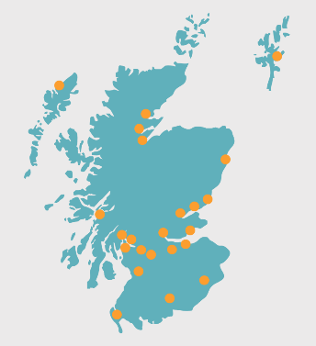
What does the future hold?
Strong integration with Public Health
Integrating brain health resources into wider Alzheimer Scotland services
Brain Health Clinics as part of the anti-amyloid treatment pathway?

Slide 15
Behaviour Change and Brain Health Ailin Chen Professional Doctorate Trainee in Health Psychology University of Stirling

Slide 16
Why psychology?
“My brother was a picture of health and had a healthy diet for his whole life … and still he got diabetes and AD. ( …)
I guess there’s nothing one can do about it, there’s nothing my brother could have done.”
Rosenberg, A., Coley, N., Soulier, A. et al. Experiences of dementia and attitude towards prevention: a qualitative study among older adults participating in a prevention trial. BMC Geriatr 20, 99 (2020). https://doi.org/10.1186/s12877-020-1493-4​

Slide 17
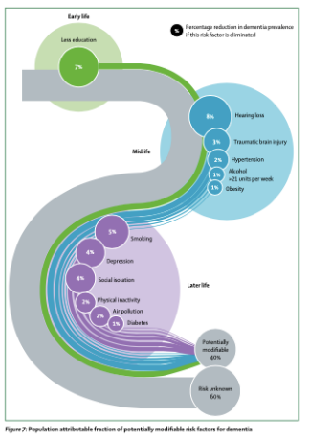
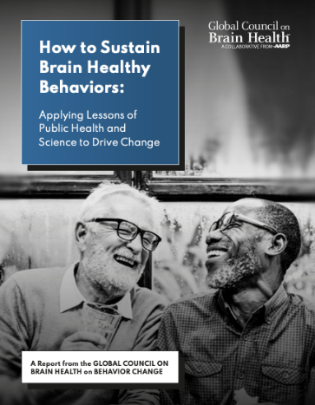
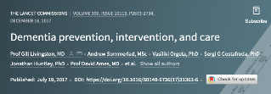
Why psychology?
“Simply putting research findings forward and expecting people to change their behaviors and sustain healthy lifestyles accordingly is unrealistic…..
engage and empower families,
Organizations and communities
with resources and skills to support brain health throughout the course of life”

Slide 18
Why psychology?
Knowledge – behaviour gap
Intention - behaviour gap
Behaviour –maintenance gap
This Photo by Unknown author is licensed under CC BY-SA.
3 gaps…

Slide 19
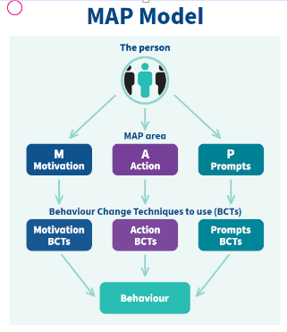
Approach
Shift from information telling to collaborating: Empowering sustainable changes
Adapt MAP framework & BCTs(techniques): Motivation, Action, and Prompt
Support with Personalised action plans: Tailored to individuals

Slide 20
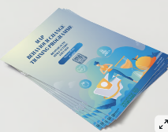
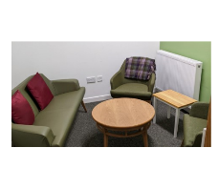
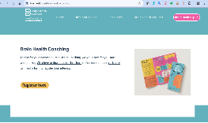
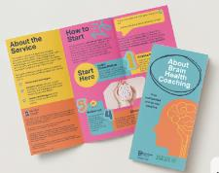
Current projects
BHDRC and Clinic Staffs Training Programme: support knowledge and skill practise in behaviour change
Pilot Brain Health Coaching Service: In-depth, individualised behaviour change risk reduction support (under supervision)

Slide 21
Feedback: Staff Training programme
“This has given me more confidence to approach sensitive issues …... I can see how this would benefit to focus on issues.” ​
“I found the course gave me more confidence and a structure to raising conversations” ​
Bit of game changer for me. Realising change is possible within the old habit and any change can only come from within to make it a reality.

Slide 22
Feedback: Clients Coaching service
“Starting this journey has been a very positive experience for me and the support from the coach has been invaluable. She is always so positive and helps me to think my way through things and make my own decisions about the steps I want to try. I am developing a greater appreciation of the importance of looking after my own health and taking care of myself. This is helping increase my confidence and self-esteem.” ​

Slide 23
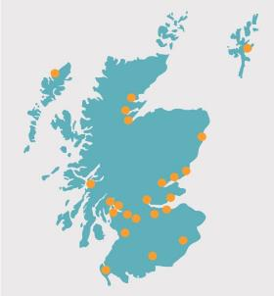
Coming Up...
Coaching Service Evaluation
Demographics/Efficacy/Process/Barriers/Facilitators/Feedback
Tailored conversation across BHDRC
Training initiative across organization
Explore further behaviour change programmes and develop resources

Slide 24
Thank you.
@brainhealthscot

Slide 25
brainhealth@alzscot.org www.brainhealth.scot @brainhealthscot @brainhealthscot
@brainhealthscot

